Slide 1
Perceptron and Artificial Neural Networks (ANN)
Tim Pengajaran
Mata Kuliah Machine Learning
Jurusan Teknologi Informasi Tahun 2021

Slide 2
Disclaimer
This presentation material, including examples, images, references are provided for informational and explanation assistance only
The names of actual products and companies mentioned here in, if any, may be the trademarks of their respective owners
Credits shall be given to the images taken from the open-source and cannot be used for promotional activities

Slide 3
Outline
What is Perceptron and Its Limitations?
What is Artificial Neural Networks (ANN)?
Nonlinear Decision Boundaries
Feed-forward and Feedback ANNs
Multi-layer Perceptrons
Training Multi-layer Perceptrons
Backpropagation
Training a multi-layer perceptron to approximate XOR
Handwritten Digits Classification

Slide 4
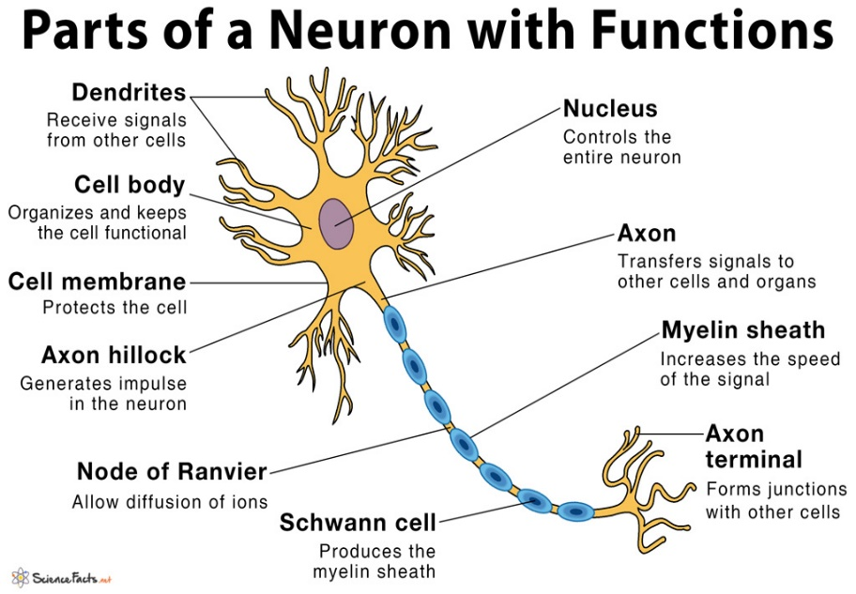
What is Perceptron?
Invented by Frank Rosenblatt in the late 1950s.
Its development was motivated to simulate the human brain.
A brain is composed of cells called neurons that process information,
Connections between neurons are called synapses, through which information is transmitted.
The human brain has been estimated to be composed of as many as 100 billion neurons and 100 trillion synapses.
The main components of a neuron are:
Dendrites ~ receive electrical signals from other neurons
Body ~ processes the signals
Axon ~ sends a signal to another neuron

Slide 5
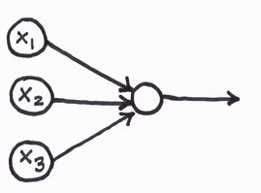
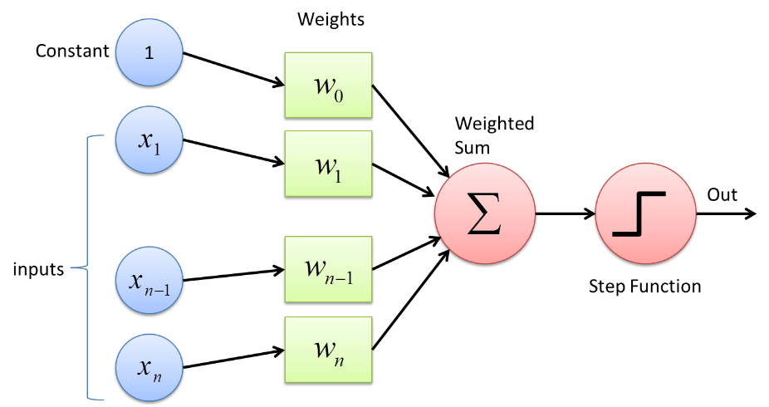
The Perceptron
Input units (dendrites)
Computational unit (body)
Weights
Outputs (axon).
Constant bias.
An individual neuron can be thought of as a computational unit that processes one or more inputs to produce an output.
A perceptron functions analogously to a neuron.
It accepts one or more inputs, processes them, and returns an output.
But, a single perceptron is incapable of approximating many functions.

Slide 6

Activation Functions
The perceptron classifies instances by processing a linear combination of the features and the model parameters using an activation function.
$$y=φ\left(\sum_{i=1}^{n}{w_{i}x_{i}}+b\right)$$
$w_{i}$ : the model's parameters
$b$ : a constant bias term
$φ$ : the activation function
$y$ : output
$n$ : the number of input or instance
$x_{i}$ : inputs or instances

Slide 7
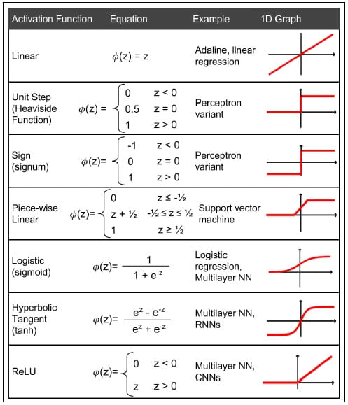
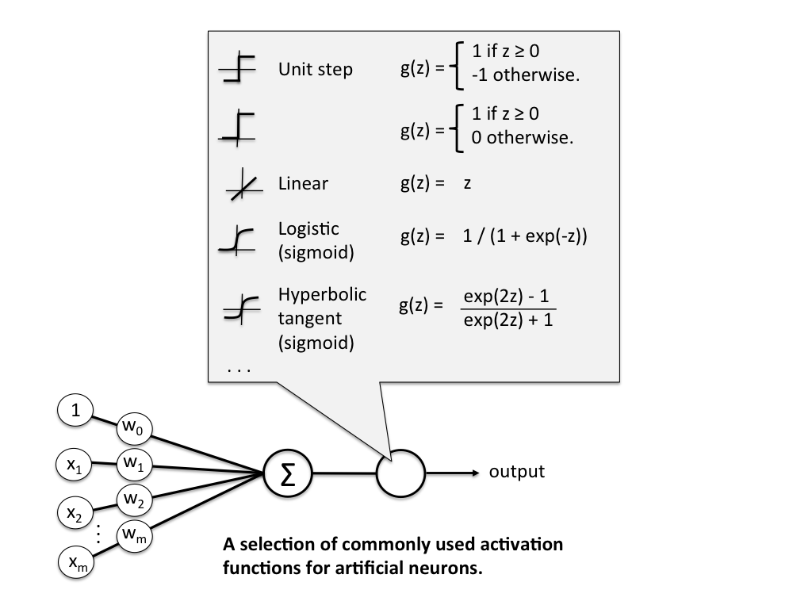
Types of Activation Function
Don’t be confused with notations

Slide 8
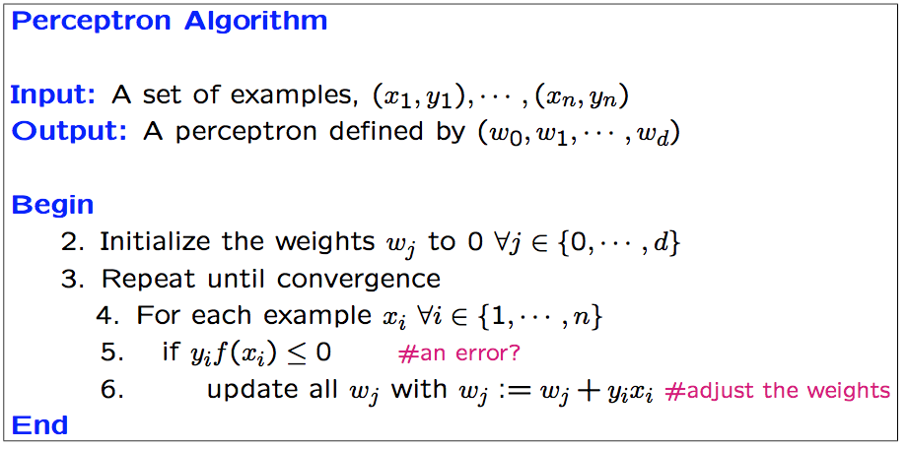
Perceptron Algorithm
Begins by setting the weights to zero, or to small random values.
Then predicts the class for a training instance.
The perceptron is an error-driven learning algorithm:
If the prediction is correct, the algorithm continues to the next instance.
If the prediction is incorrect, the algorithm updates the weights.

Slide 9
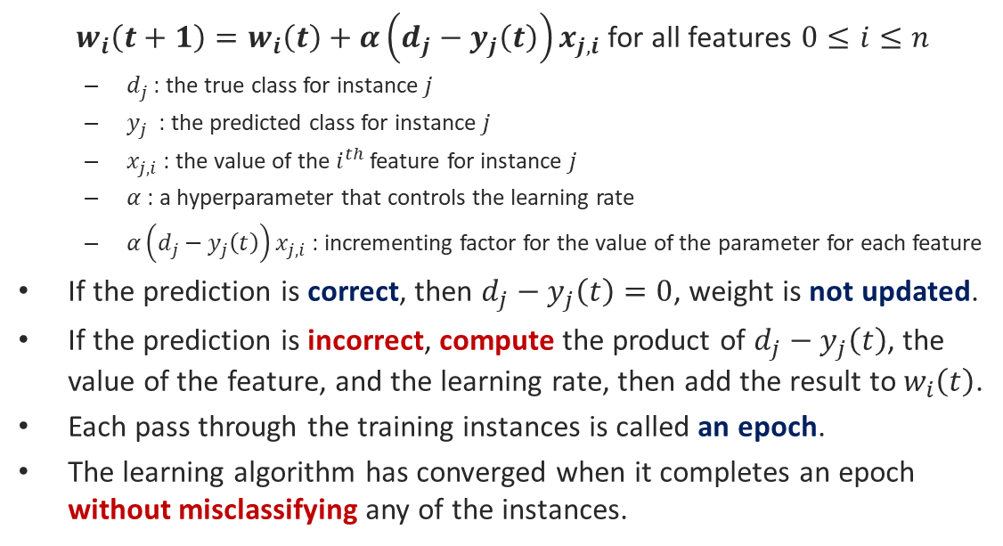
Weights Updating
$w_{i}\left(t+1\right)=w_{i}\left(t\right)+α\left(d_{j}−y_{j}\left(t\right)\right)x_{j,i}$ for all features $0≤i≤n$
$d_{j}$ : the true class for instance $j$
$y_{j}$ : the predicted class for instance $j$
$x_{j,i}$: the value of the $i^{th}$ feature for instance $j$
$α$: a hyperparameter that controls the learning rate
$α\left(d_{j}−y_{j}\left(t\right)\right)x_{j,i}$ : incrementing factor for the value of the parameter for each feature
If the prediction is correct, then $d_{j}−y_{j}\left(t\right)=0$, weight is not updated.
If the prediction is incorrect, compute the product of $d_{j}−y_{j}\left(t\right)$, the value of the feature, and the learning rate, then add the result to $w_{i}\left(t\right)$.
Each pass through the training instances is called an epoch.
The learning algorithm has converged when it completes an epoch without misclassifying any of the instances.

Slide 10
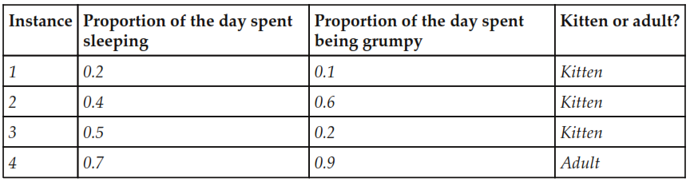
Binary Classification
Only two explanatory variables are available in the dataset:
the proportion of the day when the animal was asleep,
the proportion of the day when the animal was grumpy.
Your task is to create a simple perceptron program and do a manual computation to understand how it works.

Slide 11
Understanding Perceptron Performance
Practicing Document classification.
Do multiclass classification by using the one-versus-all strategy to train a classifier for each of the classes in the training data.
Do it yourself and explain each steps in the codes concisely.

Slide 12
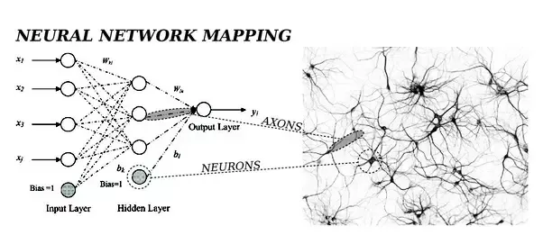
What is ANN?
If the perceptron is analogous to a neuron, an ANN, or neural net, is analogous to a brain.
As billions of neurons with trillions of synapses comprise a human brain, an ANN is a directed graph of artificial neurons.
The graph's edges are weighted; these weights are the parameters of the model that must be learned.

Slide 13
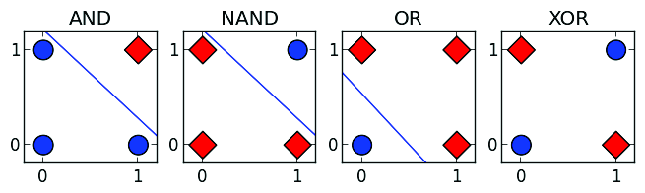
Nonlinear Decision Boundaries
Perceptron is unable to solve XOR problem. It is solved by applying ANN.
An ANN is built from multiple artificial neurons that each approximates a linear function.
Each instance's feature representation will be input to two neurons; one neuron will represent NAND and the other will represent OR.
The output of these neurons will be received by a third neuron that represents AND to test that both of XOR's conditions are true.

Slide 14
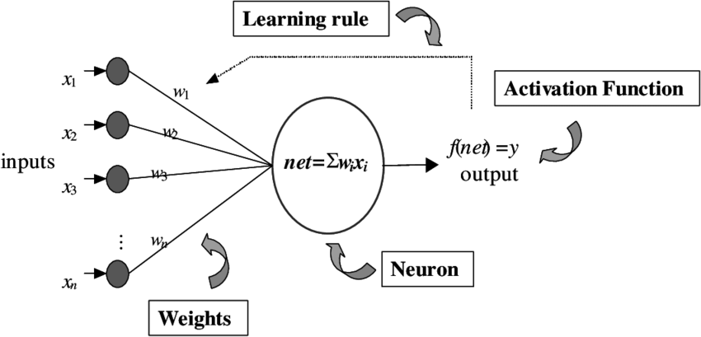
ANN Components
Architecture or topology, which describes the types of neuron and the structure of the connections between them, including neuron and its weights.
The activation functions used by the artificial neurons.
The learning algorithm or learning rule, that finds the optimal values of the weights.

Slide 15
ANN Types
Feed-forward neural networks
Defined by their directed acyclic graphs.
Information travels in one direction only, towards the output layer.
Commonly used to learn a function to map an input to an output.
Feedback neural networks, or recurrent neural networks
Contain cycles.
The feedback cycles can represent an internal state for the network that can cause the network's behavior to change over time based on its input.
Suitable for processing sequences of inputs.

Slide 16
Feed-forward Neural Networks

Slide 17
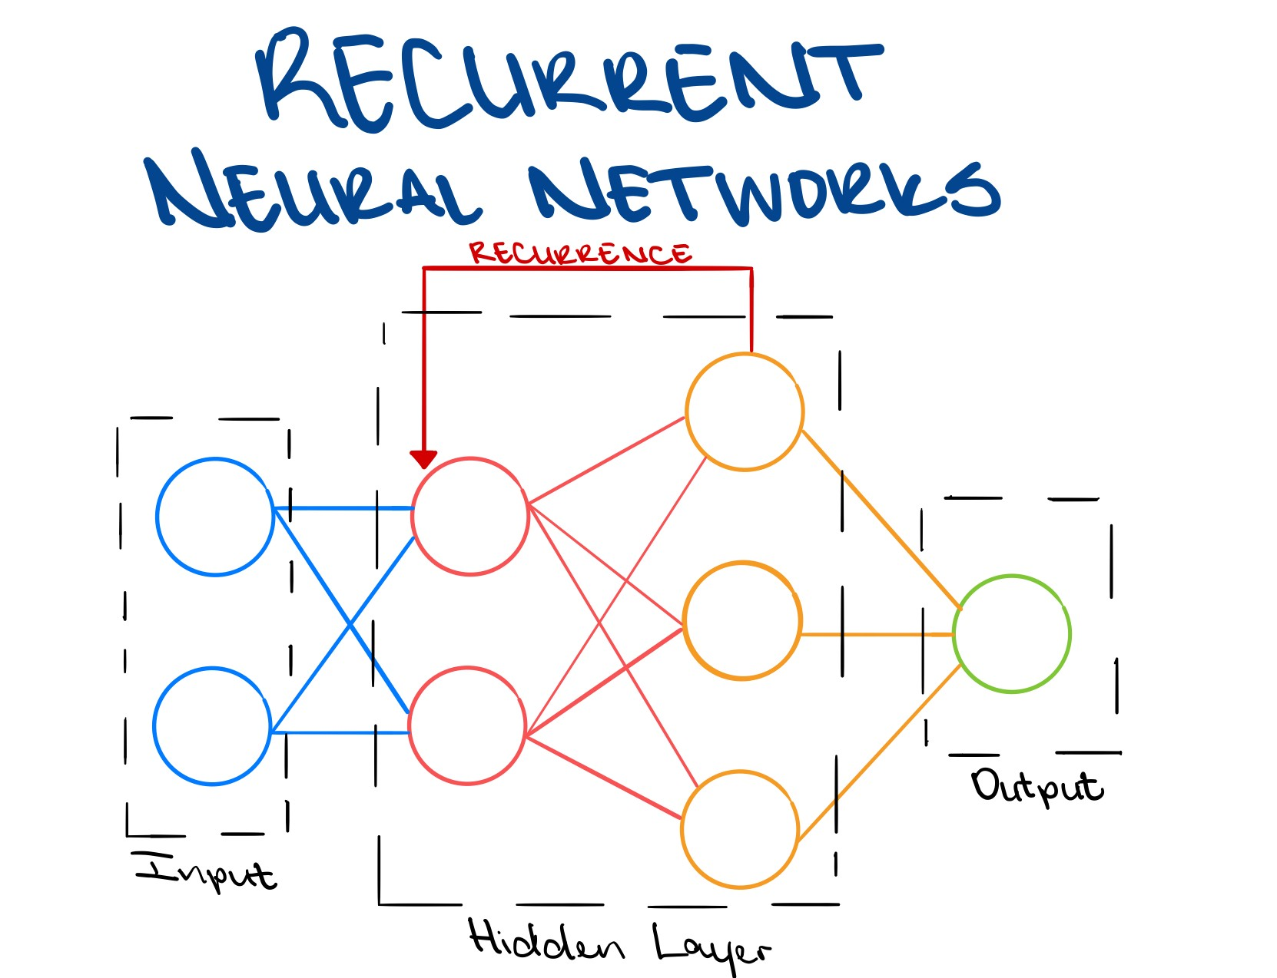
Recurrent Neural Networks

Slide 18
Multi-layer Perceptrons (MLP)
Multiple layers of artificial neurons that resemble perceptrons.
Have three or more layers of artificial neurons that form a directed, acyclic graph.
Each layer is fully connected to the subsequent layer:
The output, or activation, of each artificial neuron in a layer is an input to every artificial neuron in the next layer.
Features are input through the Input layer.
The simple neurons in the input layer are connected to at least one Hidden layer.
Hidden layers represents latent variables; these cannot be observed in the training data.
The hidden neurons in these layers are often called hidden units.
The last hidden layer is connected to an Output layer; the activations of this layer are the predicted values of the response variable.

Slide 19
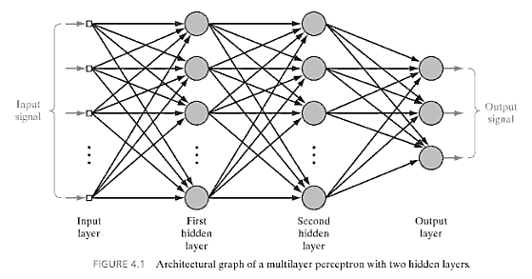
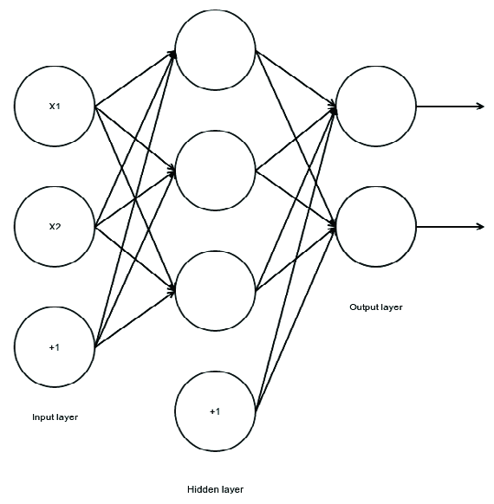
MLP Architecture

Slide 20
Backpropagation
The algorithm's name is a portmanteau of backward propagation.
Refers to the direction in which errors flow through the layers of the network when calculating the gradients.
Commonly used in conjunction with an optimization algorithm like gradient descent to train feed-forward neural networks.
Theoretically be used to train a feedforward network with any number of hidden units arranged in any number of layers.
An iterative algorithm.
Forward propagation.
Backward popagatioan.

Slide 21
The Mechanism
In the forward pass (the first phase), inputs are propagated through the network's layers of neurons until they reach the output layer. The loss function can then be used to calculate the error of the prediction.
The second phase is backward propagation. Errors are propagated backward from the cost function towards the inputs so that each neuron's contribution to the error can be approximated.
This process is based on the chain rule, which can be used to calculate the derivative of the composition of two or more functions.

Slide 22
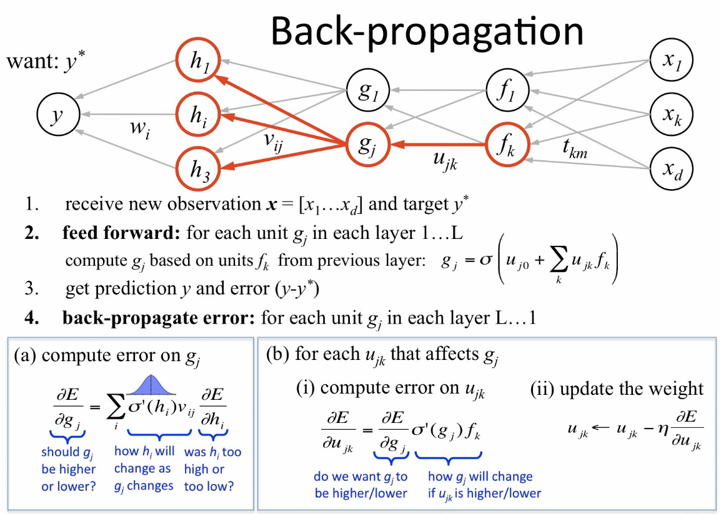
Backpropagation Algorithm

Slide 23
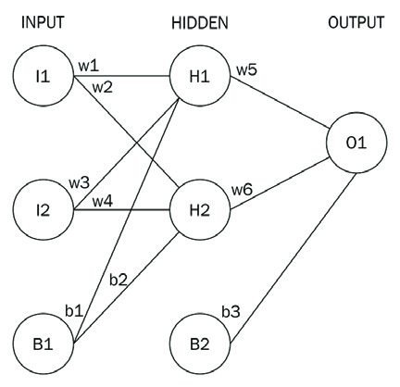
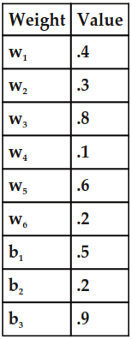
Practicing ANN with Backpropagation
Your task will be:
Train a neural network with two input units, one hidden layer with two hidden units, and one output unit.
Do the computation yourself and compare your results to the example in the book.

Slide 24
Homeworks
Training a multi-layer perceptron to approximate XOR
Training a multi-layer perceptron to classify handwritten digits

Slide 25
Thank You for Today
Always Keep Your Spirit!

